Slide 1
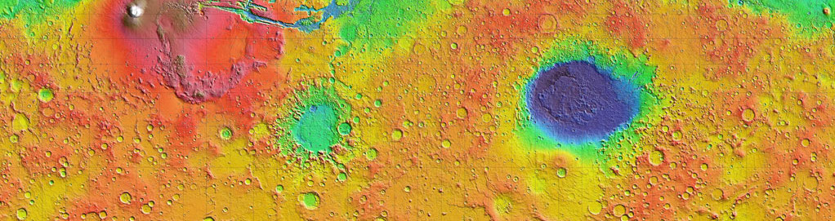


Comparison of Seasonal Surface Temperatures for CO2 Ice and H2O Ice Near the Martian South Pole
Paras Angell and Phil Christensen
School of Earth and Space Exploration,
Arizona State University

Slide 2
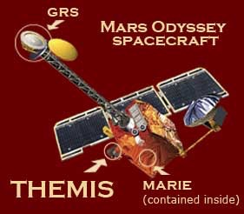
The South Pole of Mars
Seasonal layer of CO₂ ice
Seasons on Mars measured in Solar Longitude, Ls
CO₂ ice sublimates in spring and summer
Visible Images
Thermal Infrared Images
South Polar ice cap, NASA.gov
THEMIS camera onboard NASA’s Mars Odyssey spacecraft

Slide 3
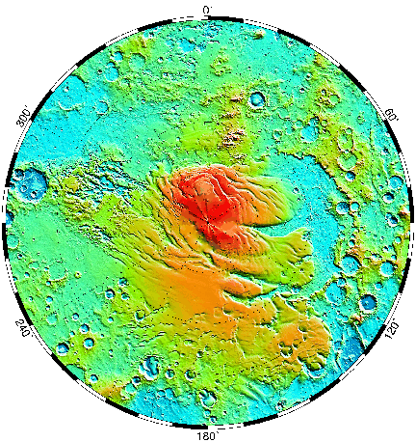
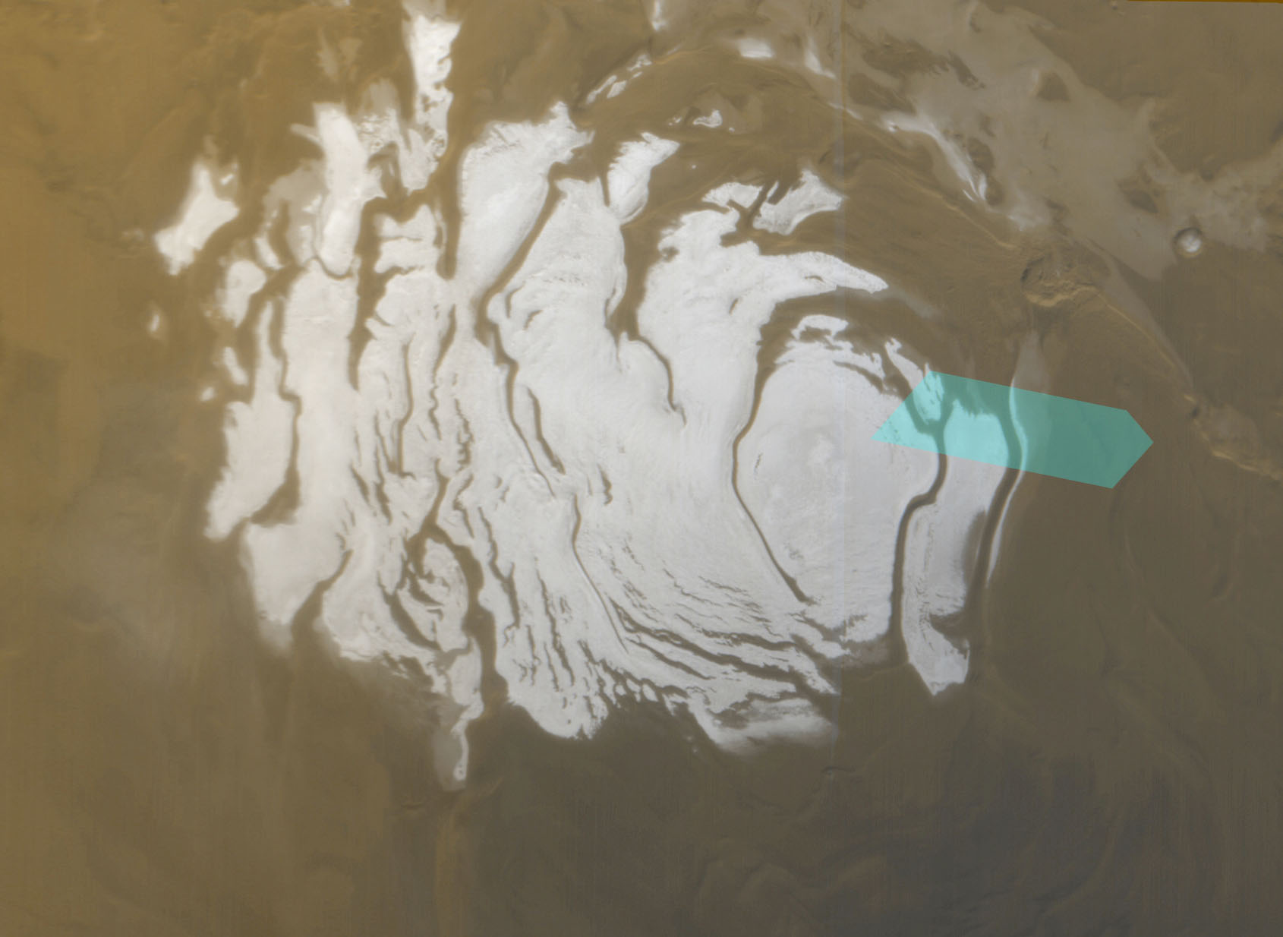
Edge of South Polar Perennial Cap
Exposed Water Ice Region
  85.4°S, 10.0°E
Exposed
H2O Ice
Manhattan
NASA image credit, MOLA Science Team
NASA image credit: Perennial South Polar Cap THEMIS.asu.edu [1]

Slide 4
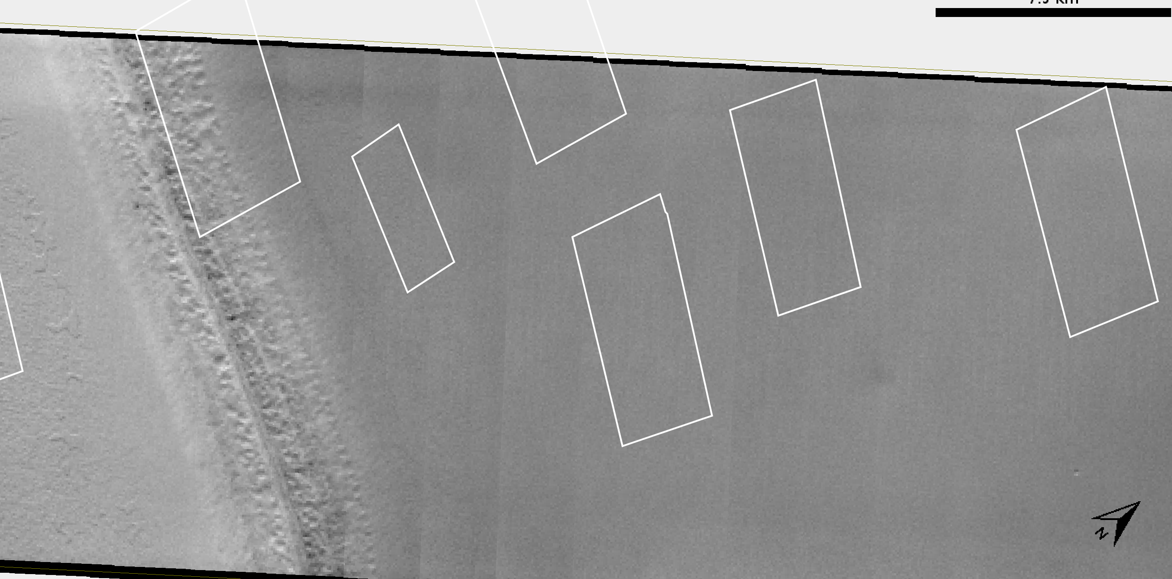
Before CO2 Sublimation (Ls 204°)
Areas of interest: A2, A5, and A6
All areas covered with CO2 ice
Uniform Temperature
10 km
A3
A1
A2
A4
A6
150 K
A5
A7
152 K
152 K
Figure 1. Visible THEMIS image, Ls 204°, Mars Year 34

Slide 5
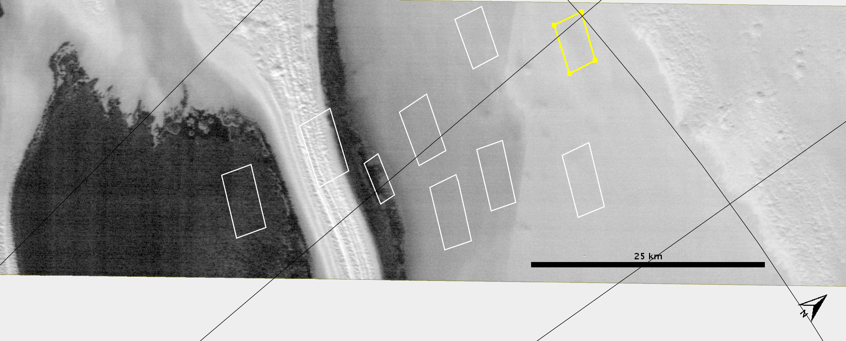
After CO2 Sublimation
Thermal infrared image — Mars Year 33, Ls 337°
Thermally distinct units are revealed
A2
A6
A5
Figure 2. THEMIS infrared image. Mars Year 33, Ls 337°

Slide 6
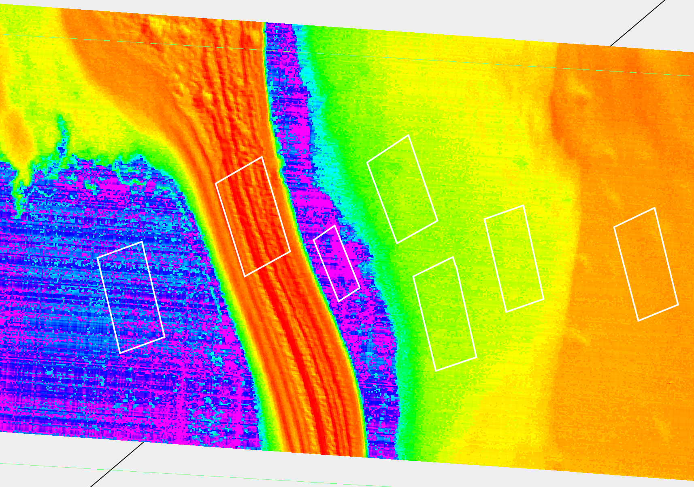
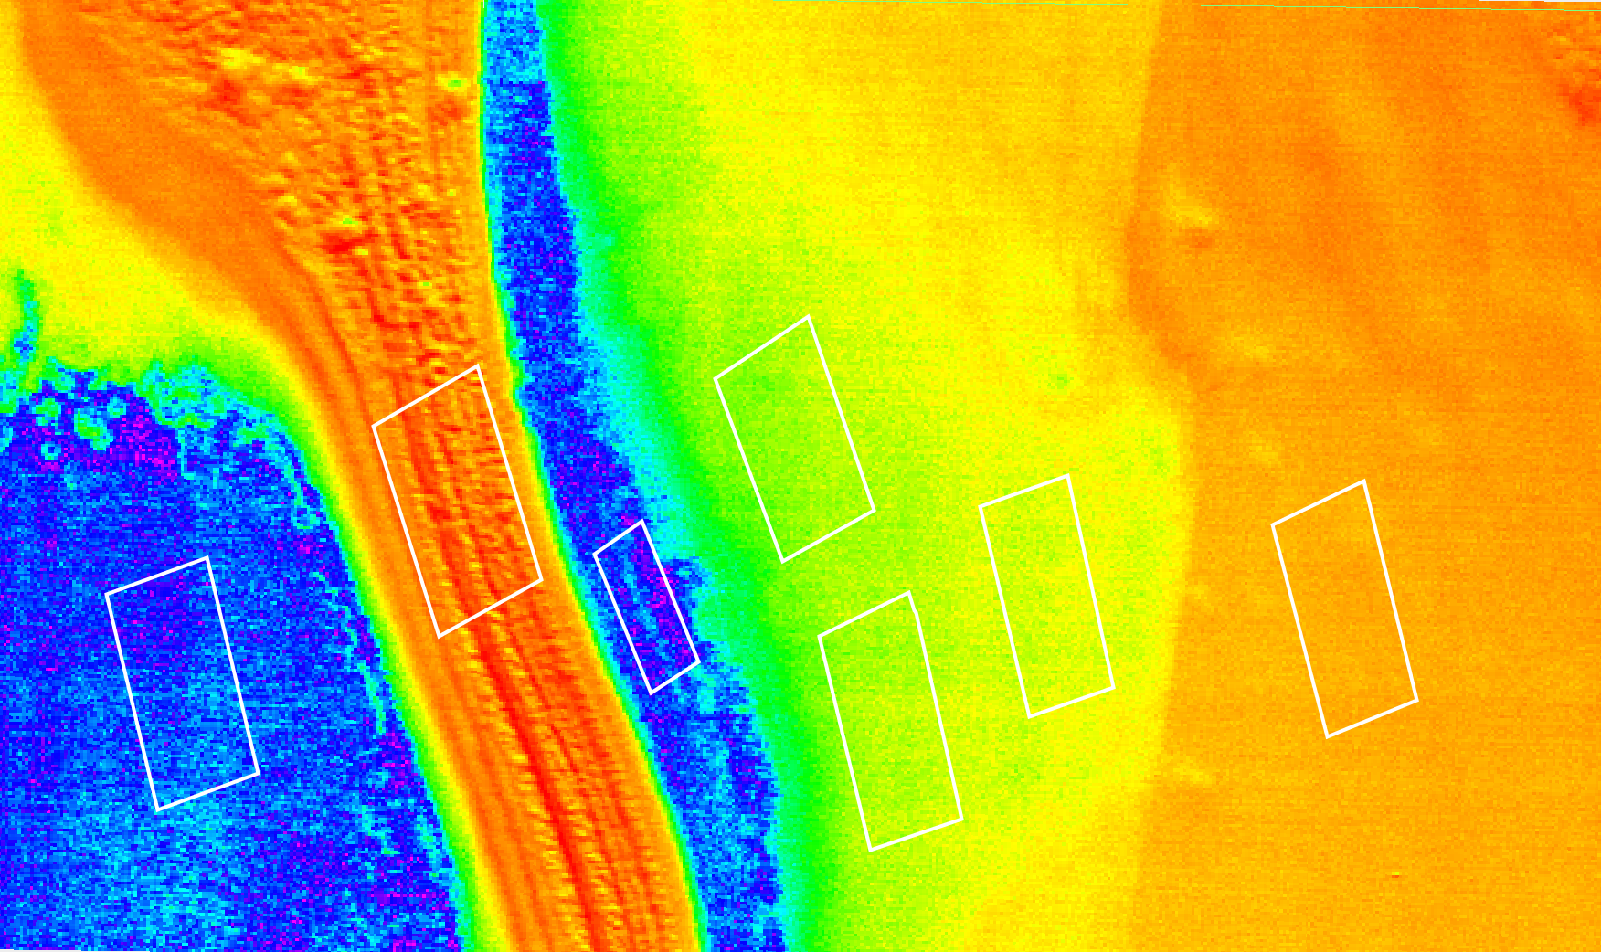
Thermal Infrared Images
(a) Mars Year 25
False color infrared images
Colors represent temperatures
  (a) Mars Year 25, Ls 334°
  (b) Mars Year 33, Ls 337°
A2 : CO₂ ice
A5 : Exposed H2O ice
A6 : Regolith
Stable boundaries over eight Mars years
A2
A6
A5
Regolith
(b) Mars Year 33
CO2 ice
H2O ice
A2
A6
A5
Figure 3. Thermal Infrared images
100 m per pixel
10 km
160K
180K
200K
220K

Slide 7
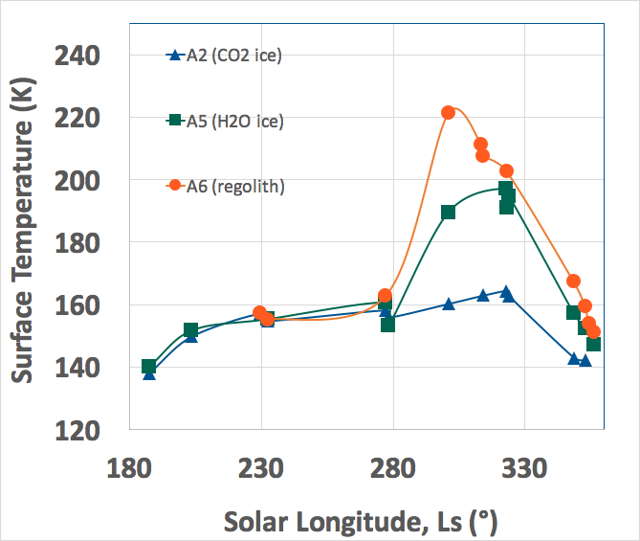
Variation of Surface Temperatures
Regolith
Spring: three areas have same surface temperature
  increases gradually from
  140 K to 160 K.
Summer: surface temperatures differentiate
At Ls 301°:
  A5 (H2O ice): 190 K (-83°C)
    30 K colder than A6 (regolith)
    30 K warmer than A2 (CO2)
H2O ice
CO2 ice
Figure 4. Average Surface Temperature vs. Ls for CO2 ice, H2O ice, and regolith (MY 32)

Slide 8
Variations in Albedo
Table 1: Albedos from visible images
 | Before CO2 Sublimation |  |  | After CO2 Sublimation
Ls (°) | 204.9° | 242.1° | 264.3° | 324.0° | 326.0° | 337.4°
A2 CO2 ice | 0.775 | 0.846 | 0.837 | 0.528 | - | 0.664
A4,A5 Exposed H2O ice | 0.755 | 0.893 | 0.823 | 0.40 | 0.416 | 0.4335
A6 regolith cover | 0.763 | 0.88 | - | 0.339 | 0.333 | 0.356
Albedo measures surface reflectivity
Albedo products calculated from visible THEMIS images
Table shows data for Mars years 32, 33, 34

Slide 9
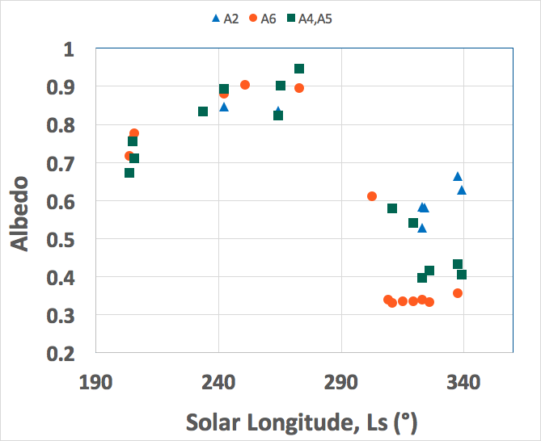
Surface Albedos
Albedos for the three areas similar during spring
After Ls 280°, the albedos differentiate
H2O ice unit has intermediate albedo
Exposed H2O ice has higher albedo than regolith
CO2 ice
H2O ice
regolith
Figure 5. Variation of Visible Albedos vs. Ls for CO2 ice, H2O ice, and regolith (MY 32, 33, 34)

Slide 10
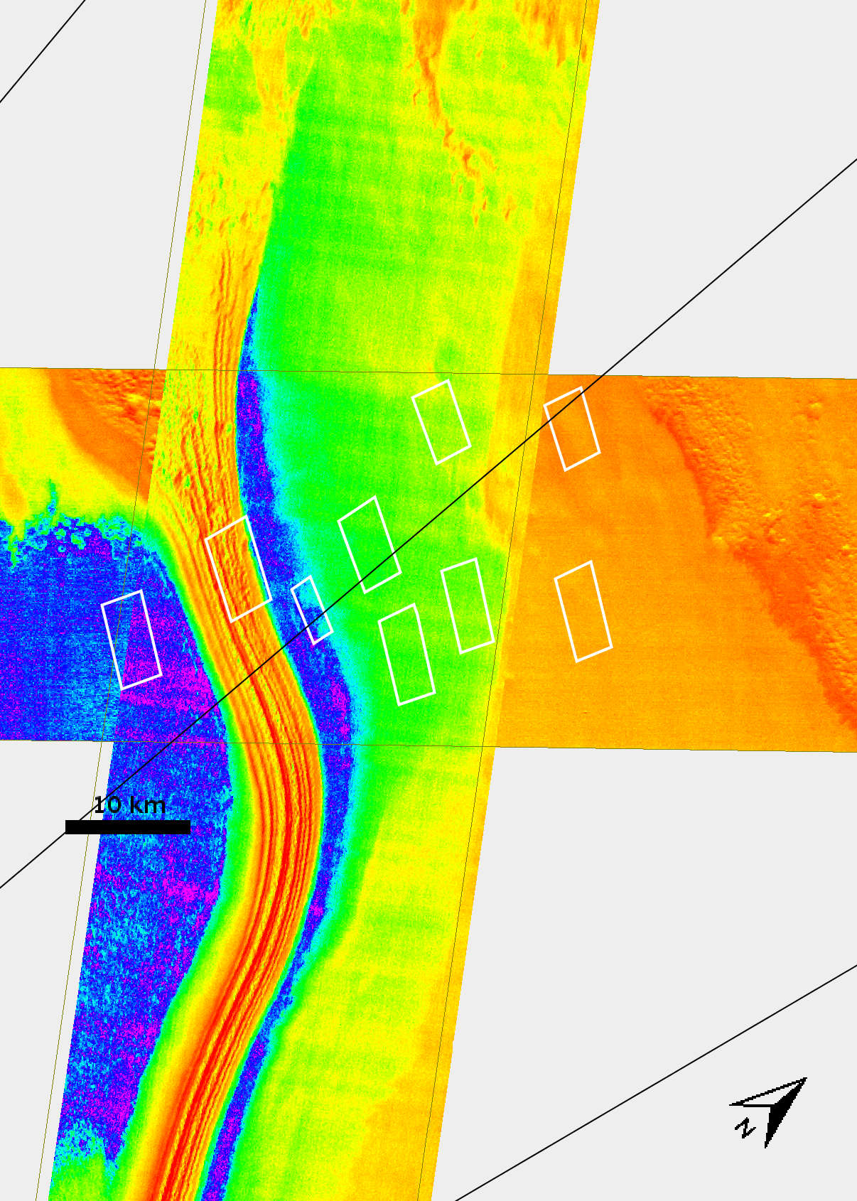
Extent of H2O Ice Region
These images show extended water ice region for Mars Year 33 summer
H2O ice unit extends more than 100 km
H2O ice is widespread around southern perennial polar cap
Figure 6. Composite Thermal Infrared images for Mars Year 33, Ls 337° and Ls 339°

Slide 11
Conclusions
♂ During spring, all areas have the same surface temperature which increases gradually from 140 K to 160 K.
♂ After Ls 280°, the surface temperatures differentiate between three units: CO2 ice, H2O ice, and regolith.
♂ The boundaries between units are stable over several Mars years
♂ H2O ice has an intermediate albedo between those of CO2 ice and regolith
♂ Area A5 is identified as H2O ice based on its temperature (190 ± 3 K) and higher albedo (0.42) than regolith (0.34).

Slide 12
Acknowledgments
I would like to thank NASA Space Grant and NASA for this amazing opportunity to conduct research.
My mentor, Prof. Phil Christensen for inspiration and guidance.
Members of the JMARS team for help with image processing.
Prof. Tom Sharp for leading the ASU/NASA Space Grant Program.
Ms. Desiree Crawl for organizing and coordinating this program.

Slide 13
References
[1] Titus, T. N., H.H. Kieffer, and P.R. Christensen, 2003. Science 299 1048-1051.
[2] Byrne, S. and A.P. Ingersoll, A sublimation model for martian south polar ice features, Science, 299, 1051-1053, 2003.
[3] Christensen, P. R. GeoScienceWorld Elements. 3(2): 151-155.
[4] Piqueux, S. and Christensen, P. R., 2008. J. Geophys. Res.113, E06005.

